Slide 1
Collaborative Knowledge Base Embedding for Recommender Systems
Fuzheng Zhang, Nicholas Jing Yuan, Defu Lian, Xing Xie, Wei-Ying Ma
Microsoft Research Asia
Notes:
Hi Everyone, I am Fuzheng Zhang, associate researcher from Microsoft research asia. It’s my great honor to present our work “collaborative knowledge base embedding for recommender systems”. This work is in collaboration with Nicholas Jing Yuan, Defu Lian, Xing Xie, and Wei-Ying Ma.

Slide 2
Overview for Recommender Systems
Limitation
Only models user interest in a user-item bipartite graph, no integration of other knowledge sources Cold start for new users and new items
Collaborative Filtering:
"Tell me what's popular among my peers"
Content based:
"Show me more of the same what I've liked "
Limitation
Lack of diversity – “more of the same”, too similar items.
Notes:
At the beginning, let’s review the basic two types of recommendation. The first is Collaborative Filtering, the core of this method is tell me what’s popular among my peers. The second one is content based, it applies user profile or item features to learn a supervised model, the core idea is “show me more of the same what I’ve liked”. Actually, there are limitations for both two methods, for cf, it only focus on user-item interaction data and ignores other information, so it has cold start problem for new users or new items. For content based methods, the recommendation is quite similar to previous ones and thus lack of diversity.

Slide 3
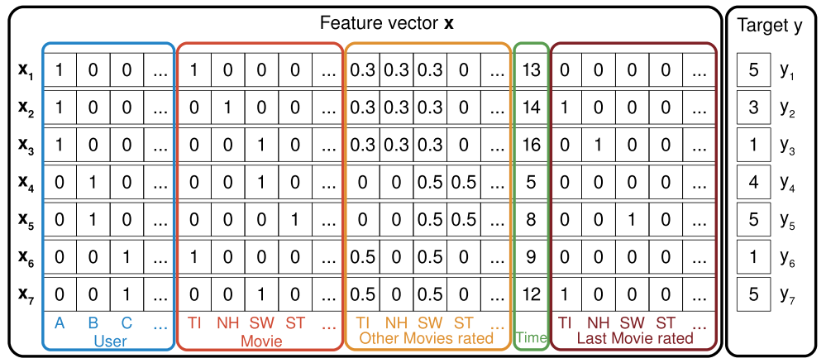
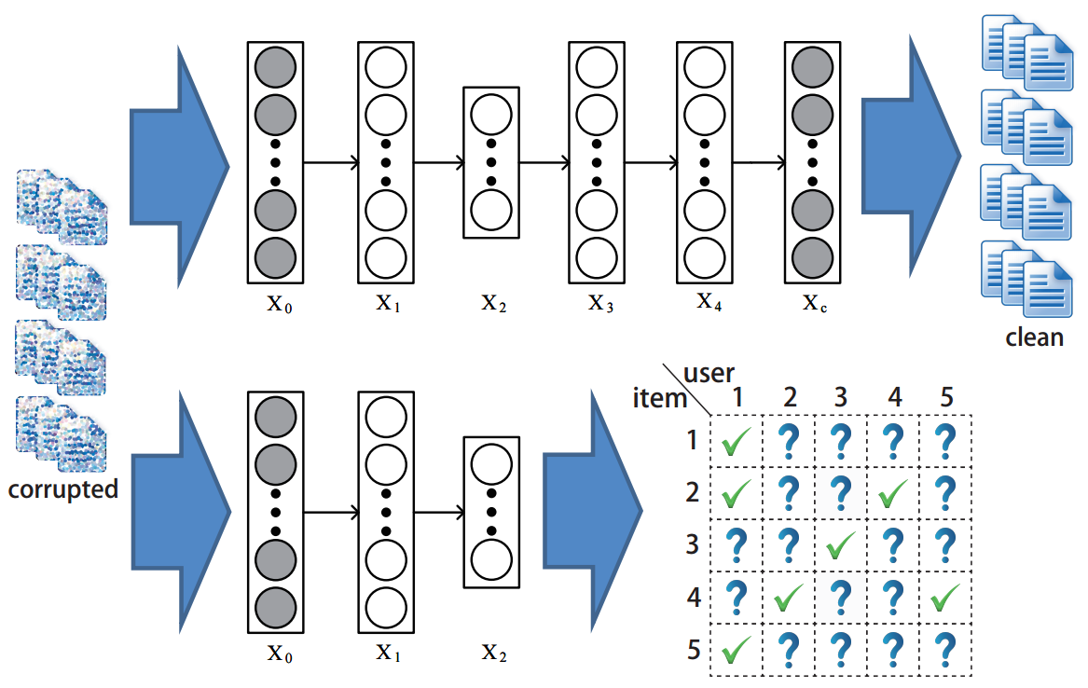
Overview for Recommender Systems
Hybrid Systems: Combine collaborative filtering and content-based methods
Factorization Machine
Notes:
Given cf and content-base have its own strength and weakness, hybrid systems are proposed to take advantage of both sides. For example, Collaborative topic regression combines cf and topic model. Collaborative deep learning step further to use deep learning to represent documents and combine with cf. LibFM is a popular tool by Steffen Rendle, it allows to feed factorization models with raw features. Meta-Path based matrix factorization, define several meta-path, each model a type of preference between users and items and conduct cf, the final results is the combination of different results. In a word, these methods are good to solve the sparsity and cold-start problem in cf, but the item content they use are only raw features or focus on single domain.
Given cf and content-base have its own strength and weakness, hybrid systems are proposed to take advantage of both sides. For example, Collaborative topic regression (Chong Wang, Princeton university), combines cf and topic model. Collaborative deep learning (Hao Wang, Hong Kong University of Science and Technology) step further to use deep learning to represent documents and combine with cf. LibFM is a popular tool by Steffen Rendle, it allows to feed factorization models with raw features. Meta-Path based matrix factorization (Jiawei Han group, University of Illinois at Urbana-Champaign), define several meta-path, each model a type of preference between users and items and conduct cf, the final results is the combination of different results. In a word, these methods are good to solve the sparsity and cold-start problem in cf, but the item content they use are only raw features or focus on single domain.

Slide 4
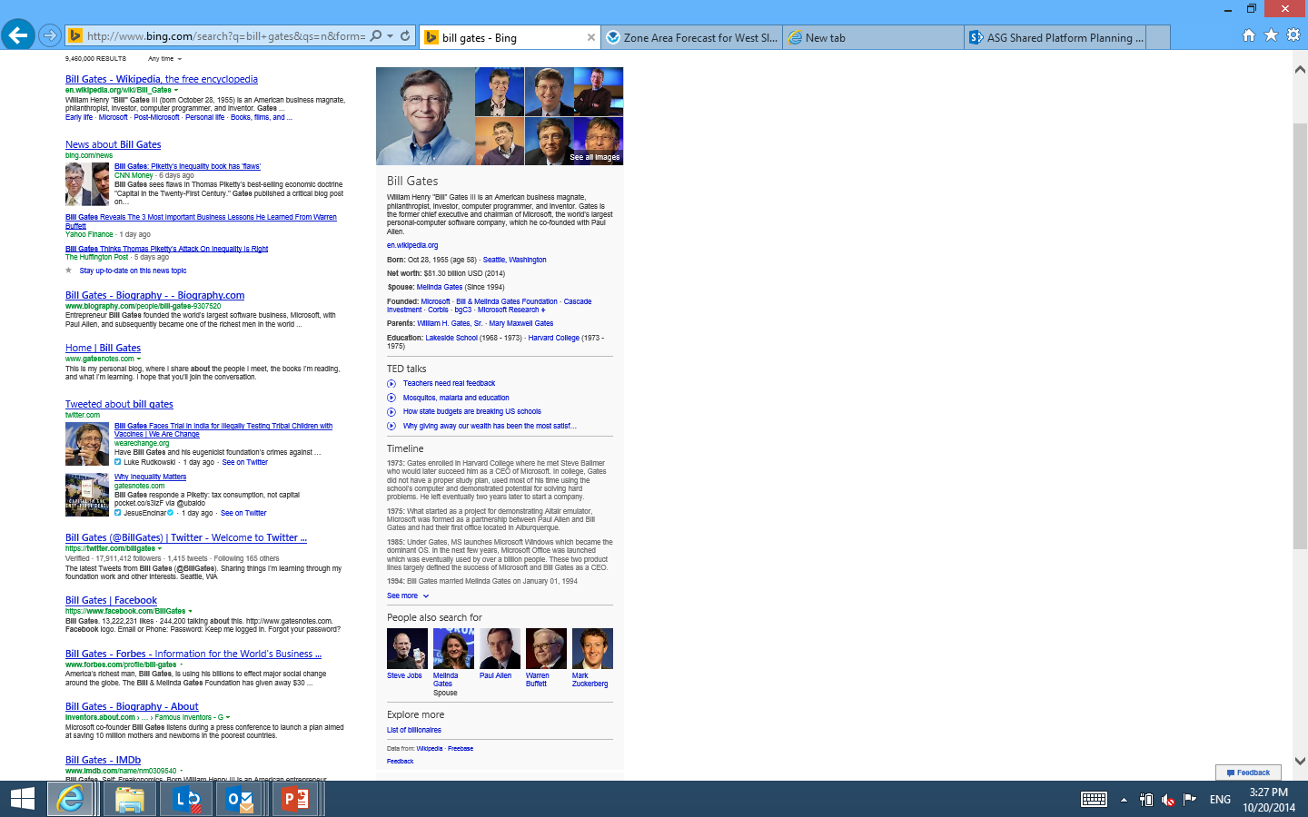
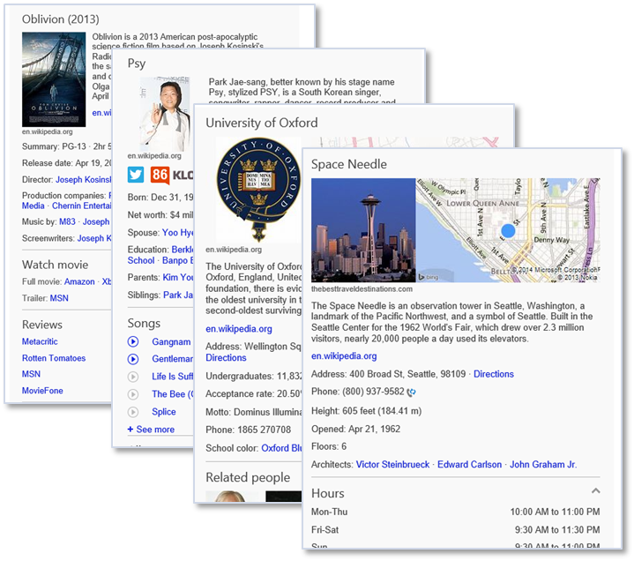
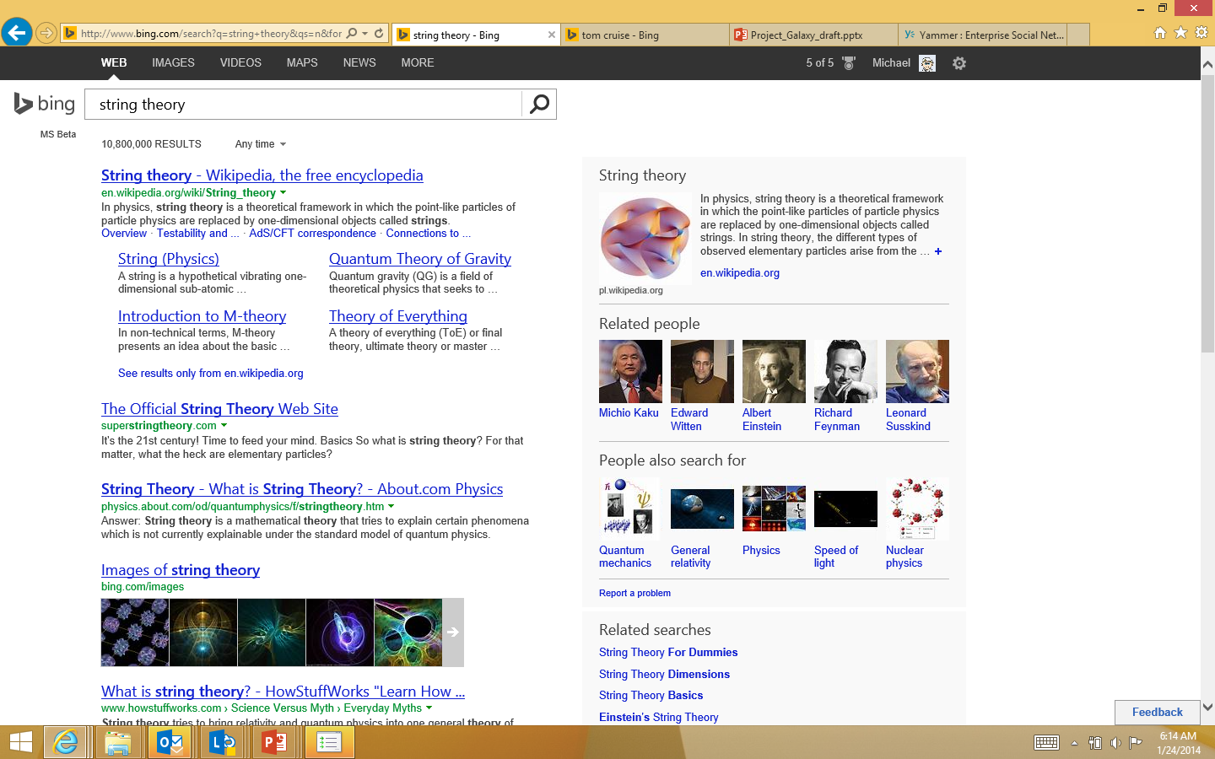
Knowledge Base
Rich structured and unstructured information
>17B Facets& Relationships
Rich Image
Description
Birth date/Place
Net Worth
Organizations
Parents
Education
Ted Talks
Timeline
…
Dozens of domains
Sports Entertainment Real Estate
Hotels/Restaurants
Places/Attractions
Fictional Characters
Apps & Games
Scientific Concepts
Historic Events
Doctors/Lawyers
Notes:
So, except for texts or raw features, actually, we want a more semantic representation of items. In recent years, there are tremendous knowledge on the web, and thus knowledge base are built to represent these heterogeneous knowledge. Take Microsoft’s satori for example, it contains rich structured and unstructured information, each entity cover rich image, textual description and other attributes. The knowledge in satori also covers dozens of domains such as sports, entertainment, restaurants and so on.

Slide 5
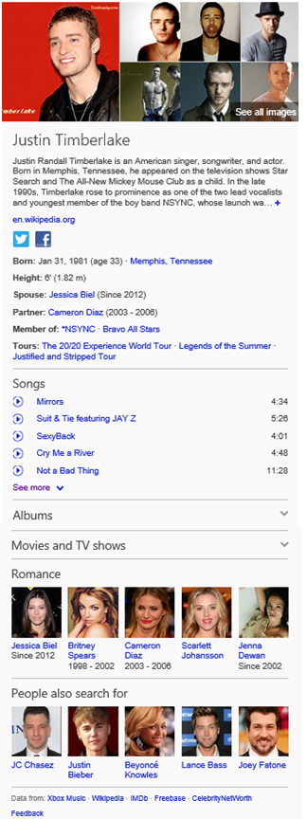
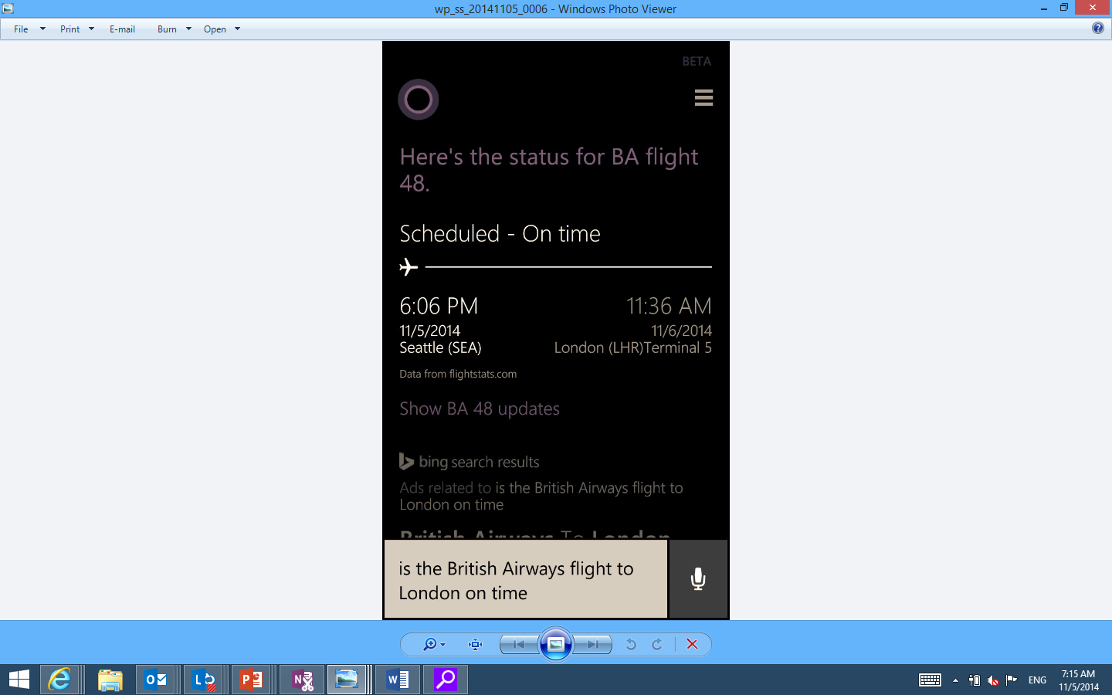

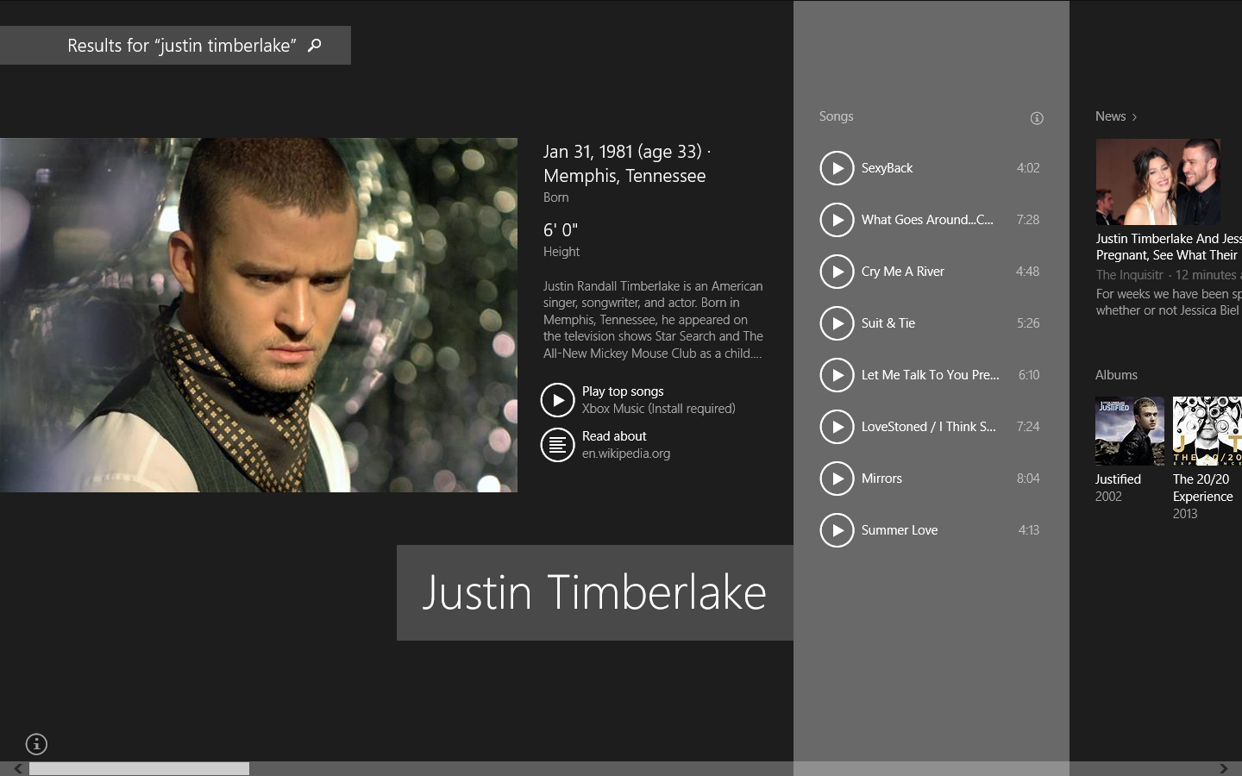
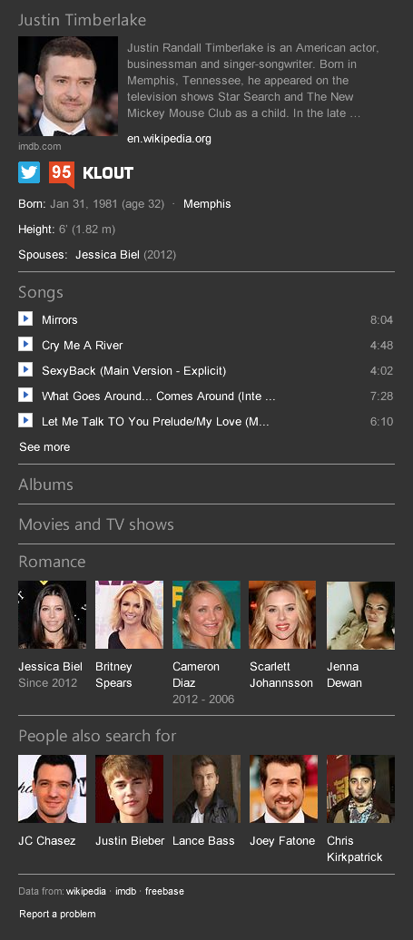
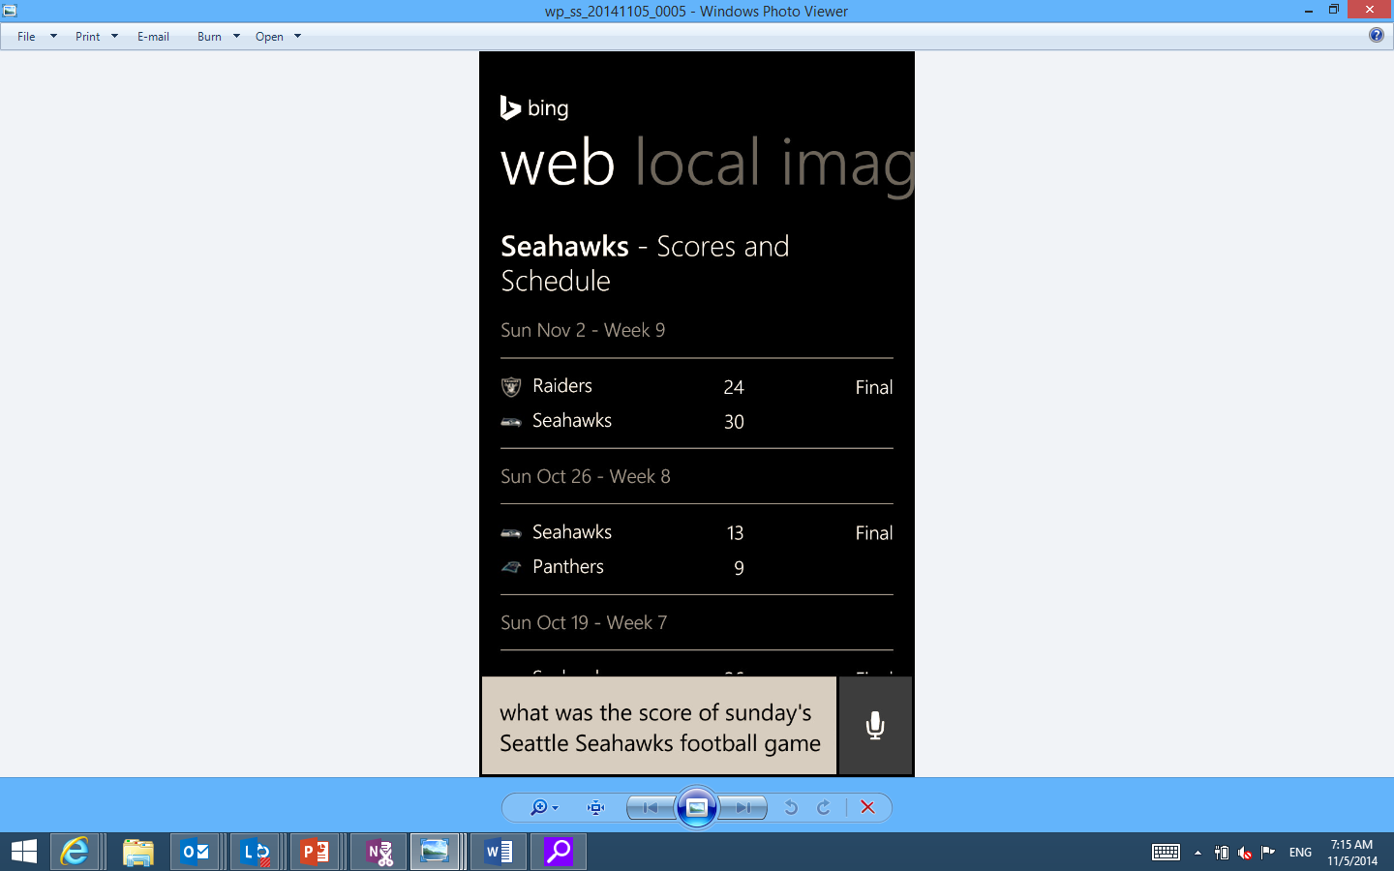
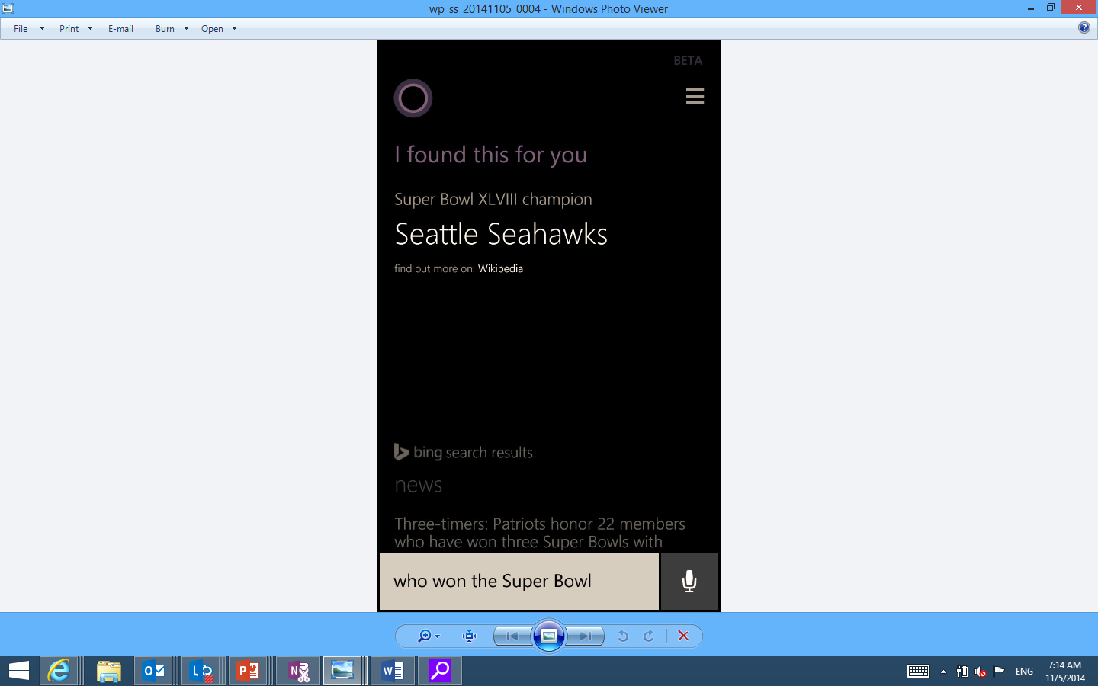
Knowledge Base
Entity Pane Experiences
Cortana Experiences
Cortana Recommendation?
Smart Search
Bing.Com
Xbox
Notes:
Actually, the heterogeneous connected information can help to solve problems which are difficult by the data from a single domain, such as bing’s entity pane experience and Cortana experience. Thus, in our work, we must answer the question, can we leverage the rich information of knowledge base to improve a hybrid recommender system.

Slide 6
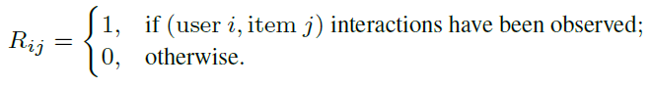
Data
User Implicit Feedback
Knowledge Base
Structural Knowledge
Textual Knowledge
Visual Knowledge
Notes:
First, let’s see our data . We focus on user implicit feedback data, where the value is one if user and item has interaction before, otherwise the value will be zero. In knowledge base, we define three types of information to describe an item. First we can connect items to other attributes to build a graph, we call this structural knowledge. There is usually some texts and images describing an item ,we call these textual knowledge and visual knowledge, respectively. For example, for book, textual knowledge is usually an introduction and visual knowledge is the front cover page; for movie, textual knowledge is usually the plot description and visual knowledge is the poster image.

Slide 7
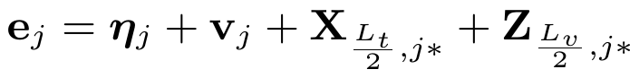
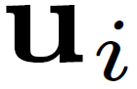
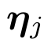
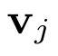
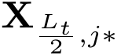
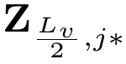
Framework
Notes:
To fully exploit knowledge base for recommendation, our framework is as follows: first given user implicit feedback on items, we find the items’s structural, textual and visual knowledges in our knowledge base. Then, there are three components to embed each type of knowledge. The final user preference for items is determined by user representation and merged item representation.

Slide 8
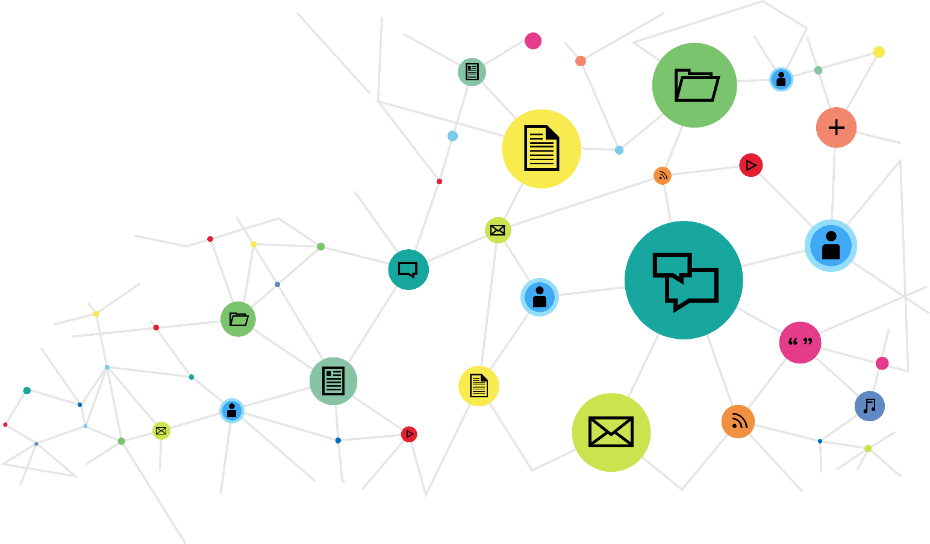
Structural Embedding
Structural knowledge is a heterogeneous undirected graph
Nodes: items and attributes
Edges: relationships
How to represent item in structural knowledge
Embedding the graph
Notes:
The structural knowledge, the knowledge graph, is a heterogeneous undirected graph. The nodes are items and their attributes, the edges are different types of relationships. The graph is huge, heterogeneous and sparse, so how can we effectively get the item representation in this graph. We refer to the network embedding approach, which is widely used for node and edge representation in a network.

Slide 9
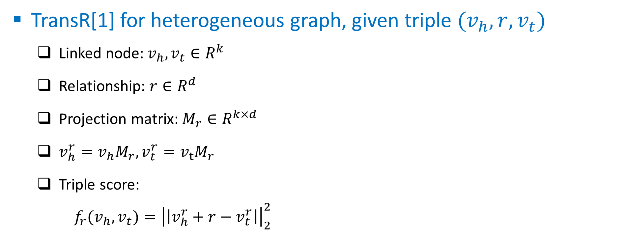
Structural Embedding
TransR[1] for heterogeneous graph, given triple $(v_{h},{r,v}_{t})$
Linked node:${ v}_{h}, v_{t}∈R^{k}$
Relationship: $r∈R^{d}$
Projection matrix: $M_{r}∈R^{k×d}$
$v_{h}^{r}=v_{h}M_{r},v_{t}^{r}=v_{t}M_{r}$
Triple score:
${f_{r}(v_{h},v_{t})=\left|\left|v_{h}^{r}+r−v_{t}^{r}\right|\right|}_{2}^{2}$
Notes:
You know, there are different types of edges, so we apply TransR, the state-of-the-art network embedding approach, to model the structural knowledge. Given node and edge vector, there is another project matrix. Because the method assume that node and edge are in different semantic spaces, so project matrix will transfer node space to edge space. Therefore, the triple score can be defined by these vectors. To learn these embedding representations, we need some negative samples, and use pair-wise ranking objective function to solve this problem.

Slide 10
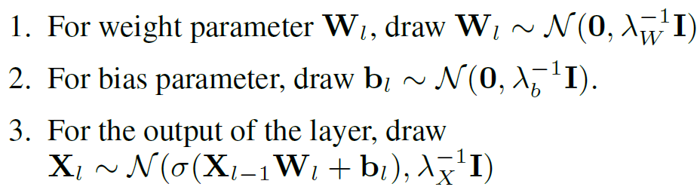
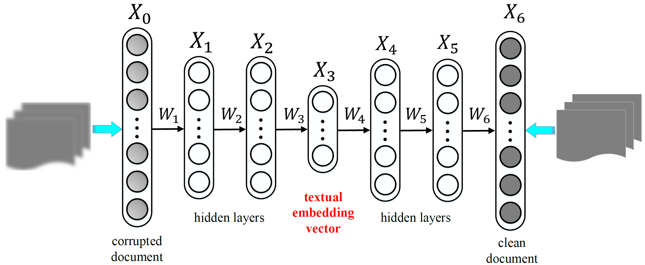
Textual Embedding
Stacked denoising auto-encoder
Notes:
For textual knowledge, recently, Deep learning has been proved to be effective in document understanding. So we apply stacked denoising auto-encoder, a kind of unsupervised deep learning method here. This is an example of the model structure for this method, to avoid overfitting, input is the textual knowledge with some nosie, the output is the original textual knowledge. Therefore, the middle layer is the semantic representation of this item’s textual knowledge.

Slide 11
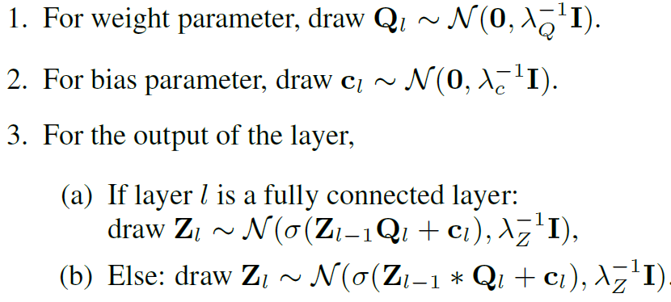
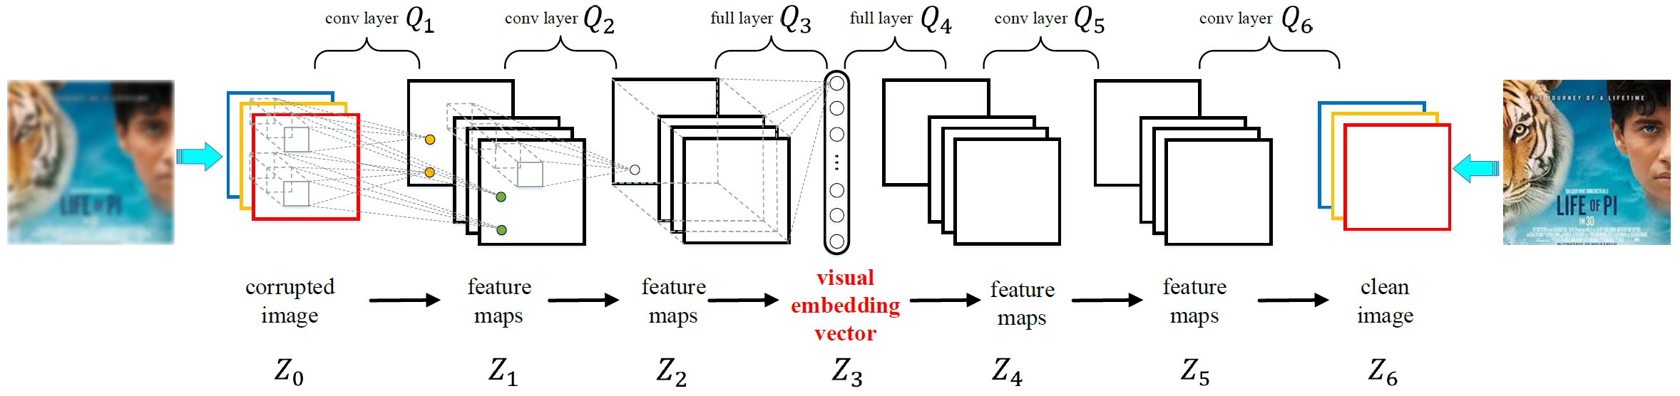
Visual Embedding
Stacked convolutional auto-encoder
Notes:
For visual knowledge, we apply similar unsupervised deep learning method. Since convolutional layers are more effective for images, so in this component, we replace all full-connected layers with convolutional layers, except the middle layer. The result in the middle layer is then the representation for visual knowledge.

Slide 12
Collaborative Joint Learning
Item representation
Collaborative filtering part
Structural knowledge part
Textual knowledge part
Visual knowledge part
Notes:
In the previous slides, we know that item has three parts of representations in the knowledge base, what is more, to model user-item interaction, there should be another item offset vector, just like those in basic collaborative filtering. Therefore, in our work, item is expressed as the sum of these four vectors. Combine with the user vector, we can apply pair-wise ranking based cf method to solve our recommendation problem. Note that the word “”Joint Learning” means that, in our framework, the cf part and three knowledge embedding part are learned at the same time, so the embedding vectors are dynamically changed.

Slide 13
Data
MovieLens-1M
Keep movies with rating = 5
Keep users with #movie > 2
IntentBooks
From 9-month query/click logs, apply entity linking to find out book entity
Randomly select 200 extracted entities, precision is 91.5%
Keep users with #book >= 5
Notes:
We use two datasets to evaluate our methods. The first is the public movieLens data, we only keep movies with rating 5 and users with more than 2 movies. Another data is the query / click logs we collect from Microsoft’ search engine Bing, we apply entity linking to find out book entity from these logs and then build user-book interaction data. For entity linking results, we randomly select 200 entities, find the precision is more than 90%, which is high enough for later steps. Simiarly, we also keep users with at least 5 books.

Slide 14
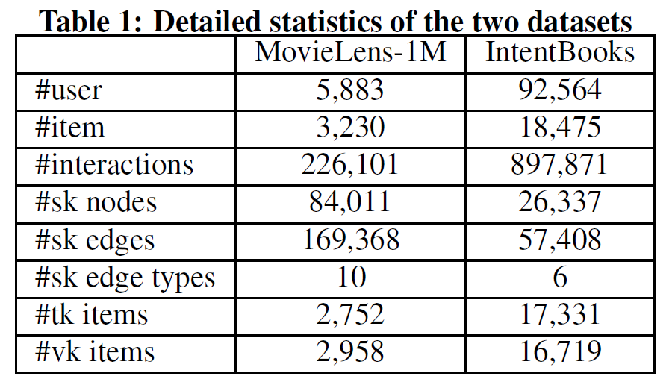
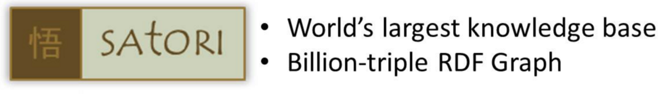
Data
MovieLens-1M
A two-staged movie-entity match (title and attributes)
Randomly select 200 pairs, 92% are correctly matched
134 movies are mis-matched
1-step subgraph such as category, director, writer, actors, language, country, production date, rating, nominated awards, and received awards
IntentBooks
1-step subgraph include category, author, publish date, belonged series, language, and rating
Notes:
For both two datasets, we use Microsoft’s Satori knowledge base. For movielens data, since movies have not been mapped to entities in Satori, we first apply a two-staged movie-entity match method for mapping. To evaluate the mapping method, we randomly select 200 pairs and find 92% percent is rightly matched and only 134 movies are not matched to any entities. To build the structural knowledge, we use 1-step subgraph from movies, including category, director, actors…
For dataset IntentBooks, book are already entities in Satori, we also use 1-step subgraph to build the structural knowledge, including category, author, publish date. This is the description of our datasets, for example.

Slide 15
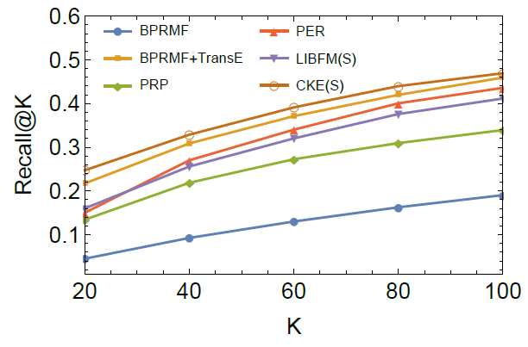
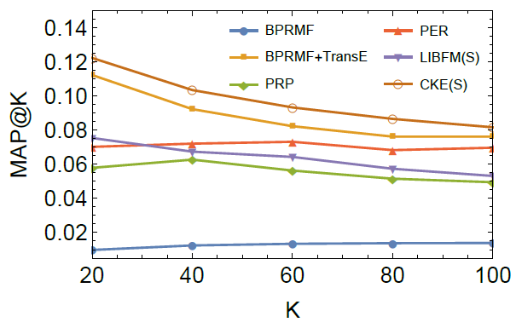
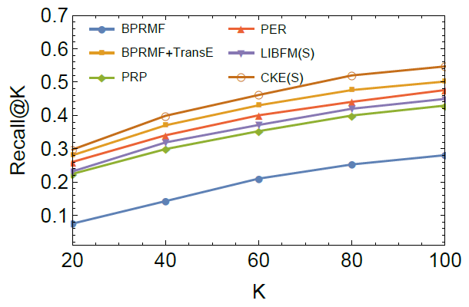
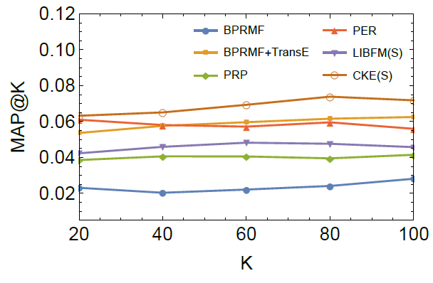
Study of Structural Knowledge Usage
Baselines
BPRMF: without structural knowledge
PRP: PageRank with Priors
PER: Personalized Entity Recommendation uses meta-path
LibFM(S): item’s attributes in the structural knowledge as raw
BPRMF+TransE: ignores the heterogeneity of edges
MovieLens-1M
IntentBooks
Notes:
First, we study the performance of each embedding component.
The basic cf method performs the worst since it totally ignores the structural knowledge. Compared with other approaches, our method is better, which demonstrate the embedding of the heterogeneous graph is effective.

Slide 16
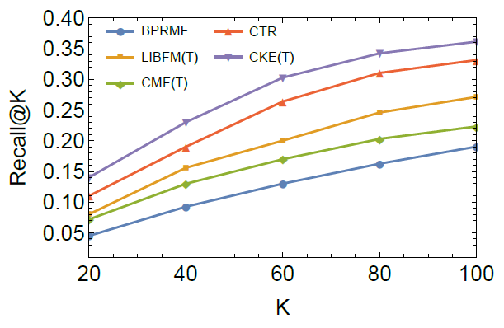
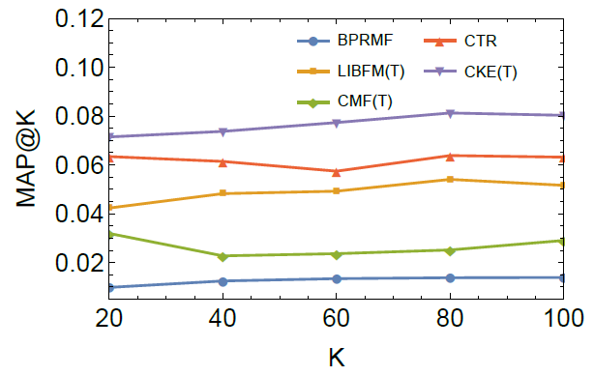
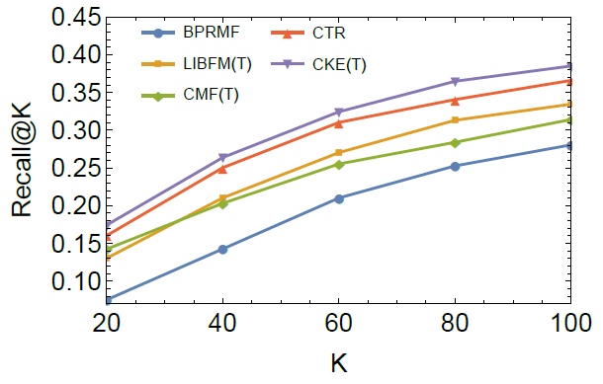
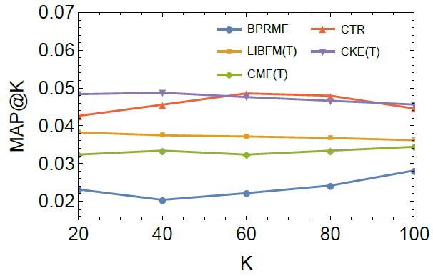
Study of Textual Knowledge Usage
Baselines
CMF(T): factorize user-item matrix and item-word matrix at the same
LibFM(T): bag of words as raw features feed into LibFM
CTR: integrates collaborative filtering and topic modeling
simultaneously
MovieLens-1M
IntentBooks
Notes:
Next, we compare some basslines on how to use textual knowledge, such as cmf, which factorize user-item matrix and item-word matrix at the same time. Libfm use bag of wors as raw features, and ctr combines topc modeling with collaborative filtering. The results show that at most of the time, using deep learning method to embed texts can give the best performance.

Slide 17
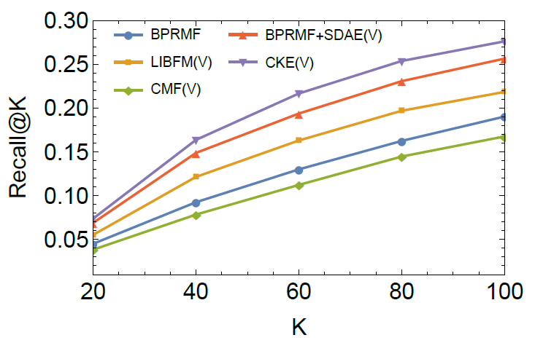
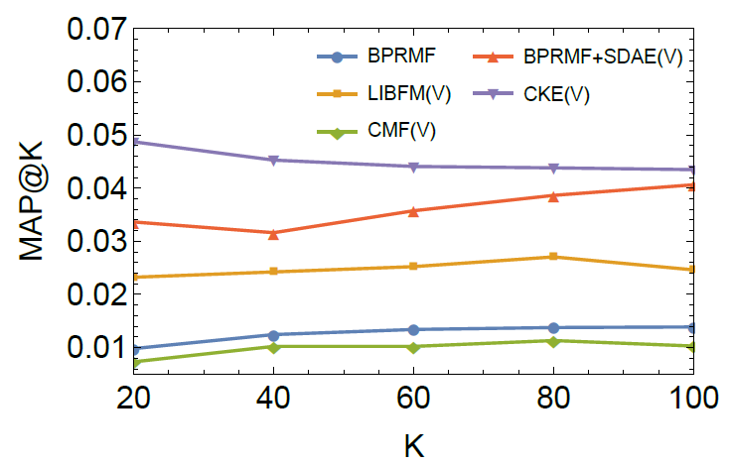
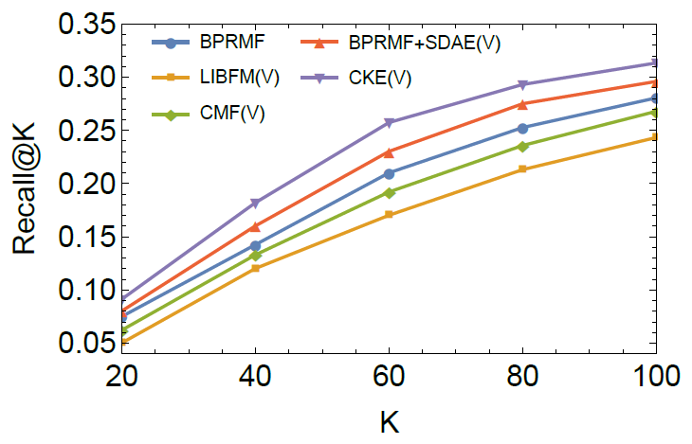
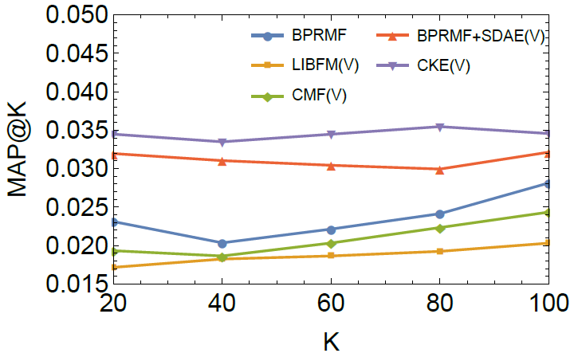
Study of Visual Knowledge
Baselines
CMF(V): factorize user-item matrix and item-pixel matrix at the same time
LibFM(V): RGB features feed into LibFM
BPRMF+SDAE(V): stacked denoising
auto-encoder to embed
MovieLens-1M
IntentBooks
Notes:
The results for visual knowledge is similar, the convolutional network embedding is better than others.

Slide 18
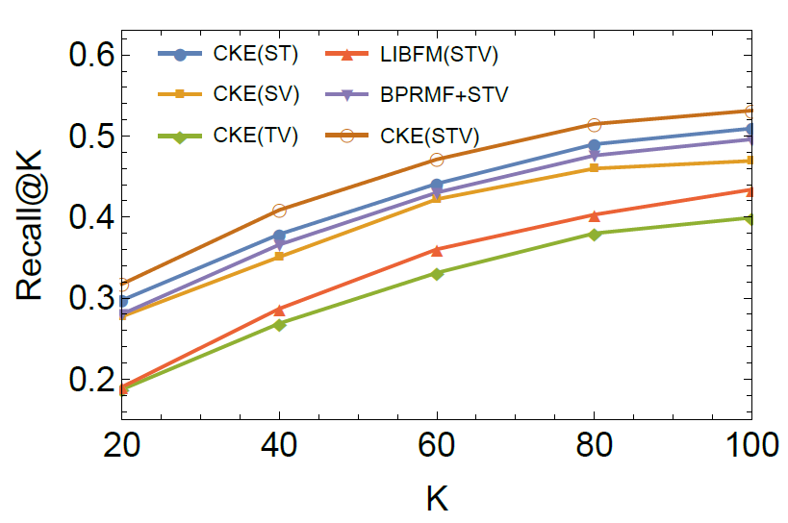
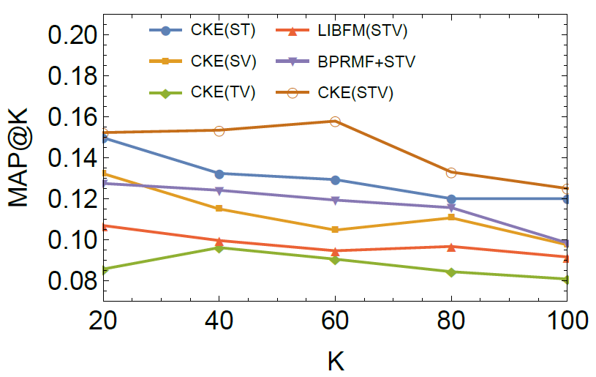
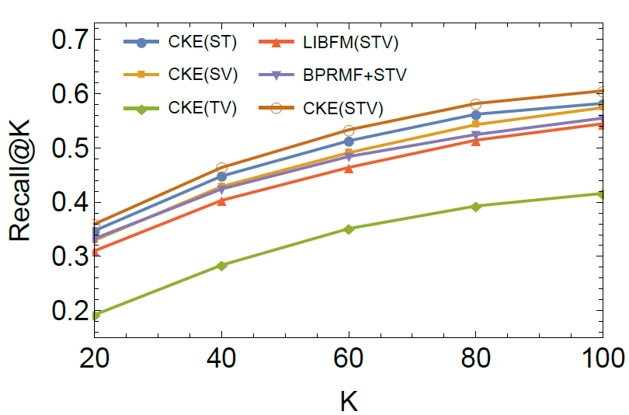
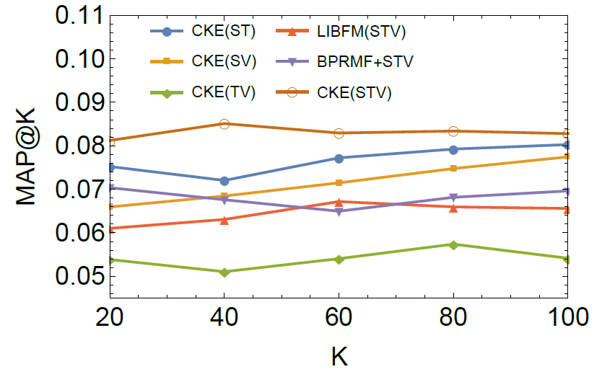
Study of Framework
Baselines
CKE(ST), CKE(SV), CKE(TV): only two types of knowledge
LIBFM(STV): all knowledge as raw features
BPRMF+STV: not joint-learning
MovieLens-1M
IntentBooks
Notes:
This is the results of the whole framework. Additional usage of each kind of knowledge can improve performance,
which demonstrate the insight of our framework combining different kinds of knowledge together. In addition, the embedding components can capture the knowledge base’s semantic representations more effectively
and thus improve the recommendation performance

Slide 19
Summary
Leverage heterogeneous information including structure, texts, and images from knowledge base for recommendation
Apply embedding methods including graph embedding and unsupervised deep learning to extract semantic representation
Integrate knowledge base embedding with collaborative filtering, our framework capture item representation and user-item interaction at the same time

Slide 20
Overview for Recommender Systems
Limitation
Only models user interest in a user-item bipartite graph, no integration of other knowledge sources Cold start for new users and new items
Collaborative Filtering:
"Tell me what's popular among my peers"
Content based:
"Show me more of the same what I've liked "
Limitation
Lack of diversity – “more of the same”, too similar items.
Notes:
At the beginning, let’s review the basic two types of recommendation. The first is Collaborative Filtering, the core of this method is tell me what’s popular among my peers. The second one is content based, it applies user profile or item features to learn a supervised model, the core idea is “show me more of the same what I’ve liked”. Actually, there are limitations for both two methods, for cf, it only focus on user-item interaction data and ignores other information, so it has cold start problem for new users or new items. For content based methods, the recommendation is quite similar to previous ones and thus lack of diversity.

Slide 21
Overview for Recommender Systems
Hybrid Systems: Combine collaborative filtering and content-based methods
Factorization Machine
Notes:
Given cf and content-base have its own strength and weakness, hybrid systems are proposed to take advantage of both sides. For example, Collaborative topic regression combines cf and topic model. Collaborative deep learning step further to use deep learning to represent documents and combine with cf. LibFM is a popular tool by Steffen Rendle, it allows to feed factorization models with raw features. Meta-Path based matrix factorization, define several meta-path, each model a type of preference between users and items and conduct cf, the final results is the combination of different results. In a word, these methods are good to solve the sparsity and cold-start problem in cf, but the item content they use are only raw features or focus on single domain.
Given cf and content-base have its own strength and weakness, hybrid systems are proposed to take advantage of both sides. For example, Collaborative topic regression (Chong Wang, Princeton university), combines cf and topic model. Collaborative deep learning (Hao Wang, Hong Kong University of Science and Technology) step further to use deep learning to represent documents and combine with cf. LibFM is a popular tool by Steffen Rendle, it allows to feed factorization models with raw features. Meta-Path based matrix factorization (Jiawei Han group, University of Illinois at Urbana-Champaign), define several meta-path, each model a type of preference between users and items and conduct cf, the final results is the combination of different results. In a word, these methods are good to solve the sparsity and cold-start problem in cf, but the item content they use are only raw features or focus on single domain.

Slide 22
Knowledge Base
Rich structured and unstructured information
>17B Facets& Relationships
Rich Image
Description
Birth date/Place
Net Worth
Organizations
Parents
Education
Ted Talks
Timeline
…
Dozens of domains
Sports Entertainment Real Estate
Hotels/Restaurants
Places/Attractions
Fictional Characters
Apps & Games
Scientific Concepts
Historic Events
Doctors/Lawyers
Notes:
So, except for texts or raw features, actually, we want a more semantic representation of items. In recent years, there are tremendous knowledge on the web, and thus knowledge base are built to represent these heterogeneous knowledge. Take Microsoft’s satori for example, it contains rich structured and unstructured information, each entity cover rich image, textual description and other attributes. The knowledge in satori also covers dozens of domains such as sports, entertainment, restaurants and so on.

Slide 23
Knowledge Base
Entity Pane Experiences
Cortana Experiences
Cortana Recommendation?
Smart Search
Bing.Com
Xbox
Notes:
Actually, the heterogeneous connected information can help to solve problems which are difficult by the data from a single domain, such as bing’s entity pane experience and Cortana experience. Thus, in our work, we must answer the question, can we leverage the rich information of knowledge base to improve a hybrid recommender system.

Slide 24
Data
User Implicit Feedback
Knowledge Base
Structural Knowledge
Textual Knowledge
Visual Knowledge
Notes:
First, let’s see our data . We focus on user implicit feedback data, where the value is one if user and item has interaction before, otherwise the value will be zero. In knowledge base, we define three types of information to describe an item. First we can connect items to other attributes to build a graph, we call this structural knowledge. There is usually some texts and images describing an item ,we call these textual knowledge and visual knowledge, respectively. For example, for book, textual knowledge is usually an introduction and visual knowledge is the front cover page; for movie, textual knowledge is usually the plot description and visual knowledge is the poster image.

Slide 25
Framework
Notes:
To fully exploit knowledge base for recommendation, our framework is as follows: first given user implicit feedback on items, we find the items’s structural, textual and visual knowledges in our knowledge base. Then, there are three components to embed each type of knowledge. The final user preference for items is determined by user representation and merged item representation.

Slide 26
Structural Embedding
Structural knowledge is a heterogeneous undirected graph
Nodes: items and attributes
Edges: relationships
How to represent item in structural knowledge
Embedding the graph
Notes:
The structural knowledge, the knowledge graph, is a heterogeneous undirected graph. The nodes are items and their attributes, the edges are different types of relationships. The graph is huge, heterogeneous and sparse, so how can we effectively get the item representation in this graph. We refer to the network embedding approach, which is widely used for node and edge representation in a network.

Slide 27
Structural Embedding
TransR[1] for heterogeneous graph, given triple $(v_{h},{r,v}_{t})$
Linked node:${ v}_{h}, v_{t}∈R^{k}$
Relationship: $r∈R^{d}$
Projection matrix: $M_{r}∈R^{k×d}$
$v_{h}^{r}=v_{h}M_{r},v_{t}^{r}=v_{t}M_{r}$
Triple score:
${f_{r}(v_{h},v_{t})=\left|\left|v_{h}^{r}+r−v_{t}^{r}\right|\right|}_{2}^{2}$
Notes:
You know, there are different types of edges, so we apply TransR, the state-of-the-art network embedding approach, to model the structural knowledge. Given node and edge vector, there is another project matrix. Because the method assume that node and edge are in different semantic spaces, so project matrix will transfer node space to edge space. Therefore, the triple score can be defined by these vectors. To learn these embedding representations, we need some negative samples, and use pair-wise ranking objective function to solve this problem.

Slide 28
Textual Embedding
Stacked denoising auto-encoder
Notes:
For textual knowledge, recently, Deep learning has been proved to be effective in document understanding. So we apply stacked denoising auto-encoder, a kind of unsupervised deep learning method here. This is an example of the model structure for this method, to avoid overfitting, input is the textual knowledge with some nosie, the output is the original textual knowledge. Therefore, the middle layer is the semantic representation of this item’s textual knowledge.

Slide 29
Visual Embedding
Stacked convolutional auto-encoder
Notes:
For visual knowledge, we apply similar unsupervised deep learning method. Since convolutional layers are more effective for images, so in this component, we replace all full-connected layers with convolutional layers, except the middle layer. The result in the middle layer is then the representation for visual knowledge.

Slide 30
Collaborative Joint Learning
Item representation
Collaborative filtering part
Structural knowledge part
Textual knowledge part
Visual knowledge part
Notes:
In the previous slides, we know that item has three parts of representations in the knowledge base, what is more, to model user-item interaction, there should be another item offset vector, just like those in basic collaborative filtering. Therefore, in our work, item is expressed as the sum of these four vectors. Combine with the user vector, we can apply pair-wise ranking based cf method to solve our recommendation problem. Note that the word “”Joint Learning” means that, in our framework, the cf part and three knowledge embedding part are learned at the same time, so the embedding vectors are dynamically changed.

Slide 31
Data
MovieLens-1M
Keep movies with rating = 5
Keep users with #movie > 2
IntentBooks
From 9-month query/click logs, apply entity linking to find out book entity
Randomly select 200 extracted entities, precision is 91.5%
Keep users with #book >= 5
Notes:
We use two datasets to evaluate our methods. The first is the public movieLens data, we only keep movies with rating 5 and users with more than 2 movies. Another data is the query / click logs we collect from Microsoft’ search engine Bing, we apply entity linking to find out book entity from these logs and then build user-book interaction data. For entity linking results, we randomly select 200 entities, find the precision is more than 90%, which is high enough for later steps. Simiarly, we also keep users with at least 5 books.

Slide 32
Data
MovieLens-1M
A two-staged movie-entity match (title and attributes)
Randomly select 200 pairs, 92% are correctly matched
134 movies are mis-matched
1-step subgraph such as category, director, writer, actors, language, country, production date, rating, nominated awards, and received awards
IntentBooks
1-step subgraph include category, author, publish date, belonged series, language, and rating
Notes:
For both two datasets, we use Microsoft’s Satori knowledge base. For movielens data, since movies have not been mapped to entities in Satori, we first apply a two-staged movie-entity match method for mapping. To evaluate the mapping method, we randomly select 200 pairs and find 92% percent is rightly matched and only 134 movies are not matched to any entities. To build the structural knowledge, we use 1-step subgraph from movies, including category, director, actors…
For dataset IntentBooks, book are already entities in Satori, we also use 1-step subgraph to build the structural knowledge, including category, author, publish date. This is the description of our datasets, for example.

Slide 33
Study of Structural Knowledge Usage
Baselines
BPRMF: without structural knowledge
PRP: PageRank with Priors
PER: Personalized Entity Recommendation uses meta-path
LibFM(S): item’s attributes in the structural knowledge as raw
BPRMF+TransE: ignores the heterogeneity of edges
MovieLens-1M
IntentBooks
Notes:
First, we study the performance of each embedding component.
The basic cf method performs the worst since it totally ignores the structural knowledge. Compared with other approaches, our method is better, which demonstrate the embedding of the heterogeneous graph is effective.

Slide 34
Study of Textual Knowledge Usage
Baselines
CMF(T): factorize user-item matrix and item-word matrix at the same
LibFM(T): bag of words as raw features feed into LibFM
CTR: integrates collaborative filtering and topic modeling
simultaneously
MovieLens-1M
IntentBooks
Notes:
Next, we compare some basslines on how to use textual knowledge, such as cmf, which factorize user-item matrix and item-word matrix at the same time. Libfm use bag of wors as raw features, and ctr combines topc modeling with collaborative filtering. The results show that at most of the time, using deep learning method to embed texts can give the best performance.

Slide 35
Study of Visual Knowledge
Baselines
CMF(V): factorize user-item matrix and item-pixel matrix at the same time
LibFM(V): RGB features feed into LibFM
BPRMF+SDAE(V): stacked denoising
auto-encoder to embed
MovieLens-1M
IntentBooks
Notes:
The results for visual knowledge is similar, the convolutional network embedding is better than others.

Slide 36
Study of Framework
Baselines
CKE(ST), CKE(SV), CKE(TV): only two types of knowledge
LIBFM(STV): all knowledge as raw features
BPRMF+STV: not joint-learning
MovieLens-1M
IntentBooks
Notes:
This is the results of the whole framework. Additional usage of each kind of knowledge can improve performance,
which demonstrate the insight of our framework combining different kinds of knowledge together. In addition, the embedding components can capture the knowledge base’s semantic representations more effectively
and thus improve the recommendation performance

Slide 37
Summary
Leverage heterogeneous information including structure, texts, and images from knowledge base for recommendation
Apply embedding methods including graph embedding and unsupervised deep learning to extract semantic representation
Integrate knowledge base embedding with collaborative filtering, our framework capture item representation and user-item interaction at the same time

Slide 38

Notes:
So this is our work, any questions?

